Slide 1
Assistive Technology & Remote Support
Examples and Resources from MN STAR Program and ARRM
Notes:
Amy – ask the audience

Slide 2
Meet the Presenters
Amy Perron
She/her
Alaina Gallagher
She/her
Notes:
Everyone

Slide 3
What is Assistive Technology?
Notes:
Amy – ask the audience

Slide 4
Notes:
Amy
Let’s investigate further into what assistive technology really is. This is an image taken from North Dakota’s assistive technology program of a gentleman in the aftermath of a snowstorm. He is outside on the sidewalk, with his winter gear on, somewhat hunched over his walker. Velcro’ed to the front of his walker is a homemade plow made of wooden 2X4’s. With this setup he can use his walker to make a path to his mailbox.
I would like you to think about whether you would you consider this assistive technology or not? Some people would argue that it’s just a few boards nailed together, while others may feel that the plow is a means of providing important independence.

Slide 5
Federal Definition
...any item, piece of equipment, or product system, whether acquired commercially off the shelf, modified, or customized, that is used to increase, maintain, or improve functional capabilities of individuals with disabilities. [20 U.S.C. Chapter 33, Section 1401 (25)].
Notes:
Amy
Keeping this gentleman in mind, I want to read to you the federal definition of what assistive technology is… Assistive Technology is…
Read definition
Using this definition, I would conclude, that the gentleman’s home-made snowplow IS in fact a piece of assistive technology. Assistive technology really is a broad range of things. It can range from low-tech to high-tech. from homemade to manufactured, or from crude to sophisticated. I, as well as other professionals such as yourselves, exist to keep tabs on the newest items and trending technology in order to find devices that meet a wide arrange of individuals with varying abilities.

Slide 6
AT Ranges from Low to High Tech
Low Tech
High Tech
Notes:
Amy
AT Ranges from Low to High Tech
High tech
Augmentative Communication
Environmental Controls
Safety monitoring systems
Low tech
Markings,
Rearranging furniture,
Adaptive cooking tools,
Adapted games,
Reaching tools,
Bathing aids
Outside ramp even helped with social isolation piece!

Slide 7
Federally-Defined Categories of AT Devices
Environmental Adaptations
Computer Related
Mobility
Recreation/Leisure
Vision
Hearing
Speech Communication
Cognition/Learning
Daily Living
Notes:
Amy
What if you don’t know what you’re looking for? The home screen of our website will have different categories listed to help you lead your search. The categories include Vision, Hearing, Speech Communication, Cognition/Learning, Daily Living, Environmental Adaptations, Computer Related, Mobility, Recreation and Leisure. These simplified categories allow a user to find specific devices to help with specific areas of interest. Housed within each category will be a large number of items that you can read over and determine if it would be useful. Again, if you need help with deciding on a device or have questions about a specific device, contact us, we are happy to help.

Slide 8
What is Remote Support?
Notes:
Alaina – ask the audience

Slide 9
Federal Definition
... Remote Support is the provision of a covered service by a staff or caregiver who is in a remote location and is engaged with a person through enabling technology that utilizes live two-way communication.
Notes:
Alaina
Keeping this gentleman in mind, I want to read to you the federal definition of what assistive technology is… Assistive Technology is…
Read definition
Using this definition, I would conclude, that the gentleman’s home-made snowplow IS in fact a piece of assistive technology. Assistive technology really is a broad range of things. It can range from low-tech to high-tech. from homemade to manufactured, or from crude to sophisticated. I, as well as other professionals such as yourselves, exist to keep tabs on the newest items and trending technology in order to find devices that meet a wide arrange of individuals with varying abilities.

Slide 10
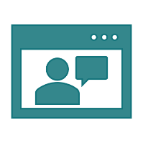
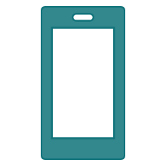
Enabling Technology
Live Audio and Video Feeds
Communication Devices
Mobile Applications
Web Based Monitoring Systems
Smart Devices
Global Positioning Systems
Notes:
Amy
What if you don’t know what you’re looking for? The home screen of our website will have different categories listed to help you lead your search. The categories include Vision, Hearing, Speech Communication, Cognition/Learning, Daily Living, Environmental Adaptations, Computer Related, Mobility, Recreation and Leisure. These simplified categories allow a user to find specific devices to help with specific areas of interest. Housed within each category will be a large number of items that you can read over and determine if it would be useful. Again, if you need help with deciding on a device or have questions about a specific device, contact us, we are happy to help.

Slide 11
Assistive Technology & Remote Support Tech Examples
Notes:
Now that we’ve given you a good overview of our program and how it works, let’s look at some specific Assistive Technology devices.

Slide 12
Vision Devices
Ruby 7” Magnifier
Orcam MyEye
LVI Magnilink
Notes:
Ruby 7 Magnifier - $1317.75
Orcam MyEye - $3,750.00
Magnilink - $3,245.00 (starting price)

Slide 13
Hearing Devices
Cell Phone Signaler
HomeAware Signaler
Personal Amplifier
Notes:
Serene Innovations Cell Phone Signaler - $69.95
Sonic Alert HomeAware Fire and CO Signaler – Starting at $201.99
William Sound Pocketalker 2.0 - $205.00

Slide 14
Speech Devices
Go Talk
Tobii Speech Case
Voice Amplifier
Notes:
GoTalk 9
Tobii Speech Case
Voice Amplifier

Slide 15
Daily Living - Medication Aids
TimeCap
MedReady
Dose Flip
Notes:
Here are a few Medication Aids that help people with medication management. Time Cap is a clinically proven pill alarm timer that is super easy to use and fits onto any regular sized pill bottle. There is a “last opened” display that indicates when the bottle was last opened to help individuals track when medications were taken. $45
MedReady automatically dispenses medication to patients up to 4 times per day. This device can be connected with MedReady’s data center so that when a patient misses a dose, it alerts caregivers of the missed medication. $190
DoseFlip is a “smart pillbox” that helps people take the right medications at the right times. At the scheduled time, Dose Flip will sound an alarm and flash a light. The circular tray will rotate to the open slot allowing the person to flip it over and remove the medication into a cup or their hands. This device can alert caregivers when medications are missed with a phone call, text message, or email. The box can be locked with a special locking mechanism so pills can’t be removed or tampered with. $60/mnthly

Slide 16
Daily Living - Motion Sensors
Wireless Wander Alarm
Wireless Floor Mat
Notes:
Here are a couple of motion sensing devices. The Wireless Wander Alarm has two components: a motion detector and a wireless remote alarm. Place the motion detector near the doorway. When someone wanders within 15 feet of the detector, a signal is sent to the alarm. The alarm will sound alerting a caregiver if someone is up and moving around. $80
The Wireless Fall and Floor Mat is a durable rubber mat with a built-in pressure sensor. If someone steps on it or falls onto it, an alert is sent to a receiver where a caregiver will be alerted. The mat is designed with beveled edges and a slip-resistant top and bottom. The mat can be hooked up to a small alarm unit for at home use or directly into a nurse-call system like an assisted living or long-term care facility would have. $113

Slide 17
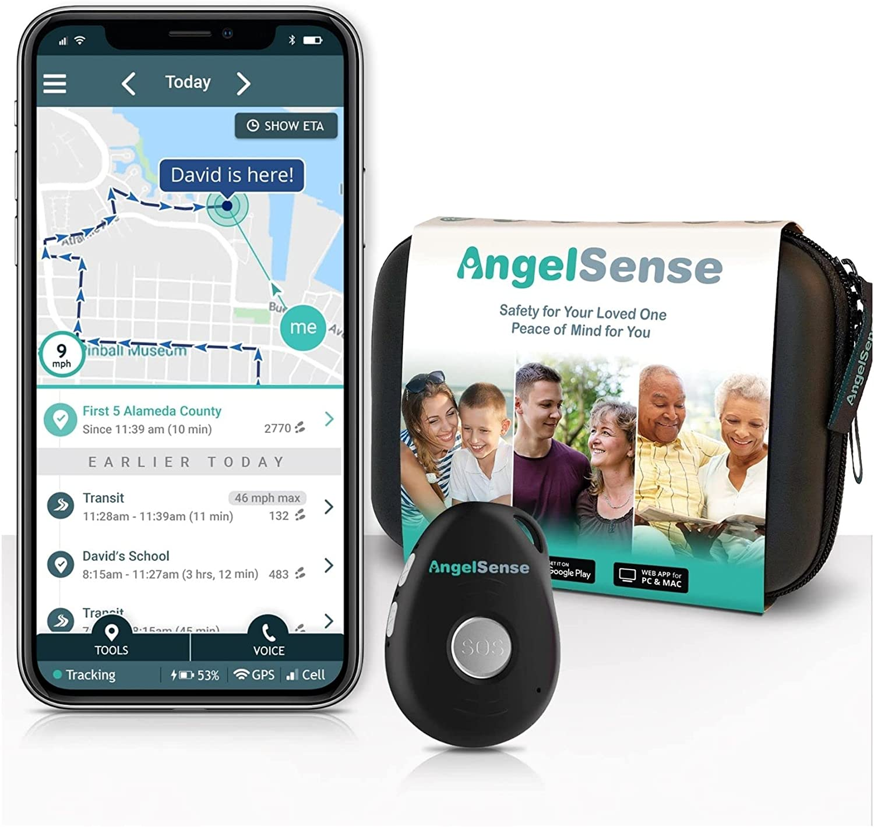
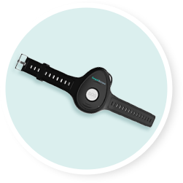
Daily Living - Personal Safety
Angelsense
Freedom Alert
Notes:
Alternative format for slide 13
Personal Safety: Freedom Alert allows you to contact family and friends at the click of a button. It is a 2-way voice communication pendant that quickly puts you in contact with up to four contacts should you need it. If your programmed contacts are unreachable, Freedom Alert can be programmed to dial 911. the pendant and call button are splash resistant, making it ideal in moist environments like the bathroom where falls are common. There are no contracts or monthly fees but does require a land-line phone.
Angelsense was originally designed for kids with autism but would also be great for those with Dementia, Traumatic Brain Injury, or anyone who unsafely wanders. With this device you can track and locate loved ones who wander with accurate location on a live map. Smart alerts allow a loved one or caregiver to be alerted to wandering and late arrivals to pre-set destinations like the doctor's office, the grocery store, etc... A built-in 2-way speakerphone will allow a caregiver to check in and and comfort them if they become lost until someone can arrive to assist. The unit also has built-in fall detection and an SOS button that can put the individual in touch with someone who can help.

Slide 18
Mobility- Adaptive Eating
Liftware Steady
Liftware Level
Notes:
Adaptive Eating: The Liftware Level has stabilizing technology that keeps the utensil level not matter what angle the wrist or hand is at. This is great for those with a diagnosis of cerebral palsy, stroke, or spinal cord injuries who have muscle spasticity or limited hand movement. It comes with a spoon, fork, and spork head attachments that are magnetically attached to the base. A rubber strap can be tightened or loosened for a comfortable grip around the entire hand. The utensil tips are dishwasher safe for easy cleaning. A charging cradle makes it easy to recharge batteries in between meals.
The Liftware Steady also has stabilizing technology that counteracts hand tremors. This is great for those with a diagnosis of Parkinson’s disease or essential hand tremors. This device has the same head attachments as the Liftware Level, and they are also dishwasher safe. The handle of this device has a bulb shape that fits nicely into the palm of your hand to provide easier grip and better stability.

Slide 19
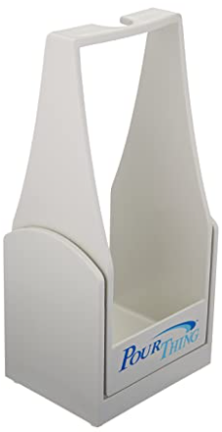
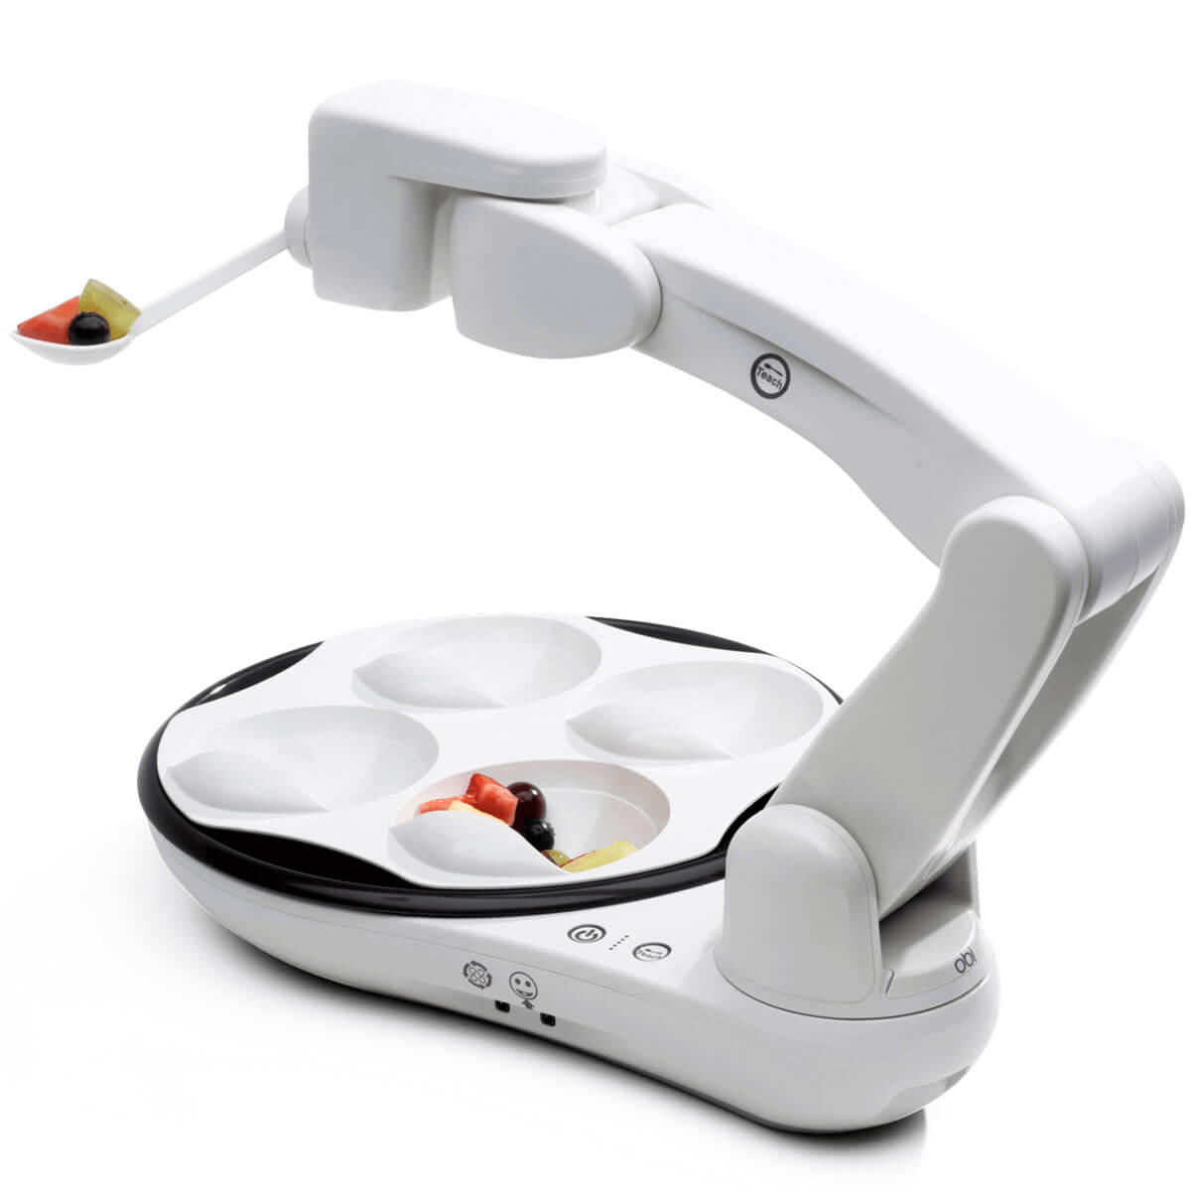
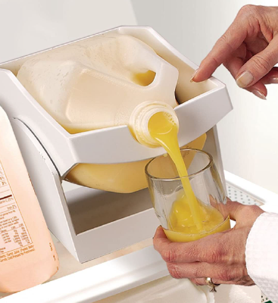
Mobility - Adaptive Eating Continued
Pour Thing
Obi Robotic Feeder
Notes:
The Pour Thing is a simple and effective design for those who need to pour liquids one-handed. Put the carton of liquid onto the cradle and tilt the spout forward to pour liquid into a glass, then slowly return it to a standing position when done. There are gallon and half-gallon sized options and it can easily fit inside the fridge. $40-$50
The Obi Robotic Feeder is a self feeding device that is operated by switches. A user would push the switch to operate the robotic arm that would swing down into the compartment and scoop up food and then swing back to the user's mouth. Another switch rotates between the 4 compartmental trays so a user can choose between different foods. $7K

Slide 20
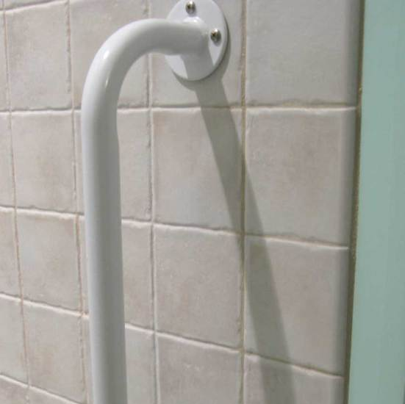
Low-Tech Environmental Adaptations
Pour Thing
This Photo by Unknown Author is licensed under CC BY-SA-NC
This Photo by Unknown Author is licensed under CC BY
Notes:
The Pour Thing is a simple and effective design for those who need to pour liquids one-handed. Put the carton of liquid onto the cradle and tilt the spout forward to pour liquid into a glass, then slowly return it to a standing position when done. There are gallon and half-gallon sized options and it can easily fit inside the fridge. $40-$50
The Obi Robotic Feeder is a self feeding device that is operated by switches. A user would push the switch to operate the robotic arm that would swing down into the compartment and scoop up food and then swing back to the user's mouth. Another switch rotates between the 4 compartmental trays so a user can choose between different foods. $7K

Slide 21
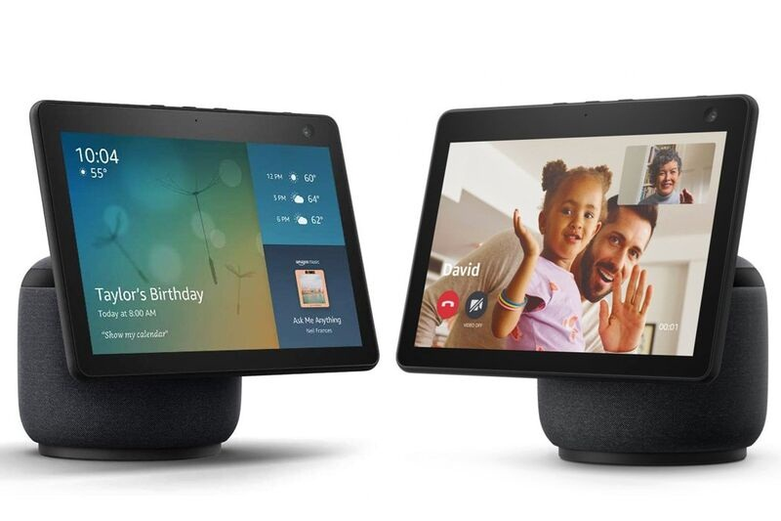
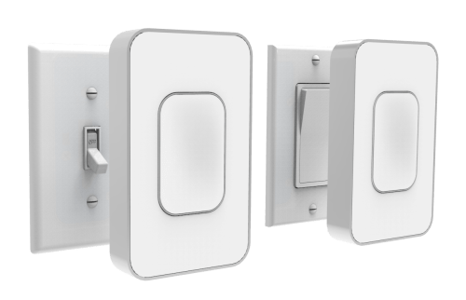
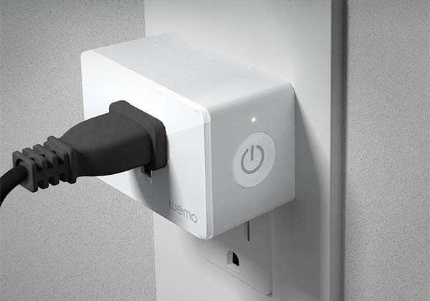
Environmental Adaptations - Smart Home
This Photo by Unknown Author is licensed under CC BY-SA-NC
This Photo by Unknown Author is licensed under CC BY-NC
This Photo by Unknown Author is licensed under CC BY-SA-NC

Slide 22
Using Mobile Devices
Built-in
Apps
MediSafe
Be My Eyes
Seeing AI
And more!
Magnifier
Flashlight
Health App
Notes:
Medisafe (free)
Magnifier

Slide 23
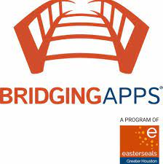
Apps
Bridging Apps - https://bridgingapps.org/
Tech Owl- https://techowlpa.org/apps-for-our-whole-lives/
Call Scotland- https://www.callscotland.org.uk/home/
CareNextion - https://carenextion.org/
Razz Mobility* - https://www.razmobility.com/
Teltex* - https://www.iaccessibility.com/apps/
Notes:
Amy
*not an endorsement. Recommending the site for their app information.

Slide 24
Seeing AI (iOS only)
Short Text
Documents
Products
Person
Scene
Currency
Light
Color
Handwriting
Notes:
Seeing AI App from Microsoft
Seeing AI app – Overview – YouTube Playlist

Slide 25
Remote Support Technology
Video Calling System
Door Sensor
Motion Sensor
Video Camera
Notes:
Seeing AI App from Microsoft
Seeing AI app – Overview – YouTube Playlist

Slide 26
Remote Support Technology
Push Button
Window Sensor
Pressure Sensor
Notes:
Seeing AI App from Microsoft
Seeing AI app – Overview – YouTube Playlist

Slide 27
Remote Support Example
Notes:
Seeing AI App from Microsoft
Seeing AI app – Overview – YouTube Playlist

Slide 28
Minnesota STAR Program
System of Technology to Achieve Results (STAR)
Minnesota’s federally funded Assistive Technology Act Program
Housed within the MN Department of Administration
Providing services to ALL MINNESOTANS
No proof of disability required.
There is no cost for the STAR Program services
Notes:
The Minnesota STAR Program is an acronym that stands for A System of Technology to Achieve Results and is our states federally funded program that stems from the Assistive Technology Act. This program is in every state across the nation including 6 U.S. territories. We are housed in the Department of Administration in St. Paul; MN and we provide services to all Minnesotans. We do not require any proof of a disability so any individual can utilize our services. There is no cost to participate in the program and our mission is to help all Minnesotans with disabilities gain access to, and acquire the assistive technology they need to live, work, learn and play.

Slide 29
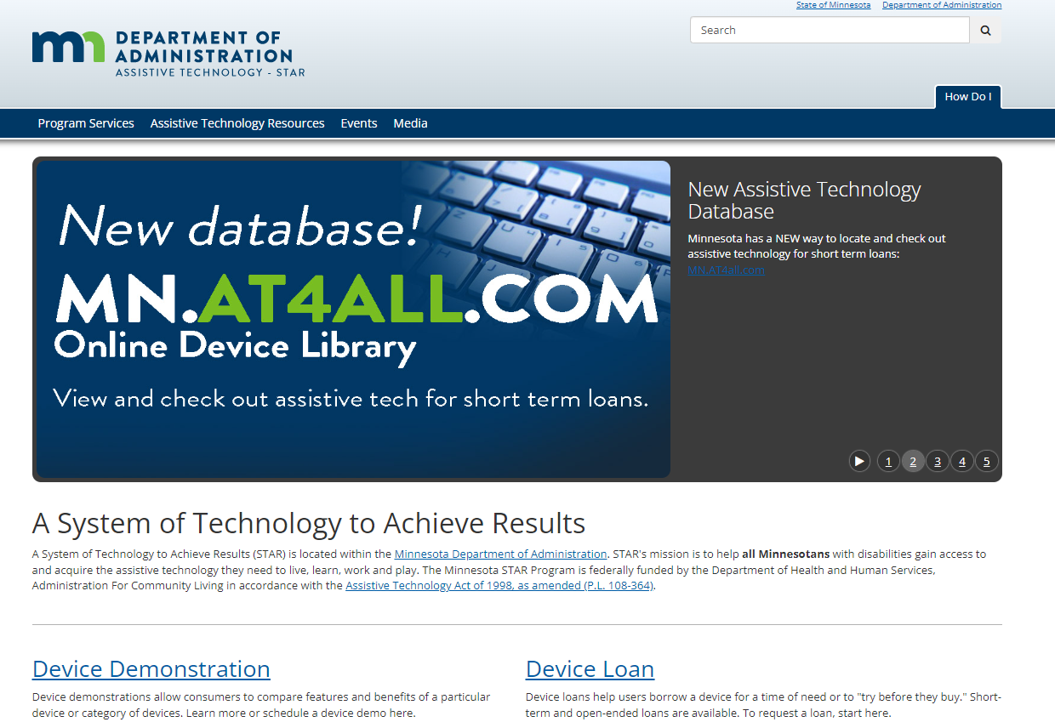
Minnesota STAR Program Services
Device Demonstrations
Device Equipment Loans
Short-term
Open-Ended (limited availability)
Information and Assistance
Training
Notes:
The STAR Program focuses on 4 main service areas including: Device Demonstrations, Device Equipment Loans (including short term loans and open-ended loans), we provide information and assistance to those seeking resources, and we provide training.

Slide 30
Online Device Library - MNAT4ALL
Notes:
Amy discuss

Slide 31
Funding
Medical insurance (including Medicare, Medicaid)
Waivers
MN STAR program (for device loans and demos)
MN State Services for the Blind
Other grants or contracts
Notes:
Alaina

Slide 32
Thank you, again!
Amy Perron
amy.perron@state.mn.us
Alaina Gallagher
agallagher@arrm.org
Notes:
Everyone

